Slide 1

Confidence Bias in Humans & Neural Networks
11-2021

Slide 2
Transfer Learning
Transfer knowledge from one domain to another
ie: trained weights in a particular neural network architecture

Slide 3
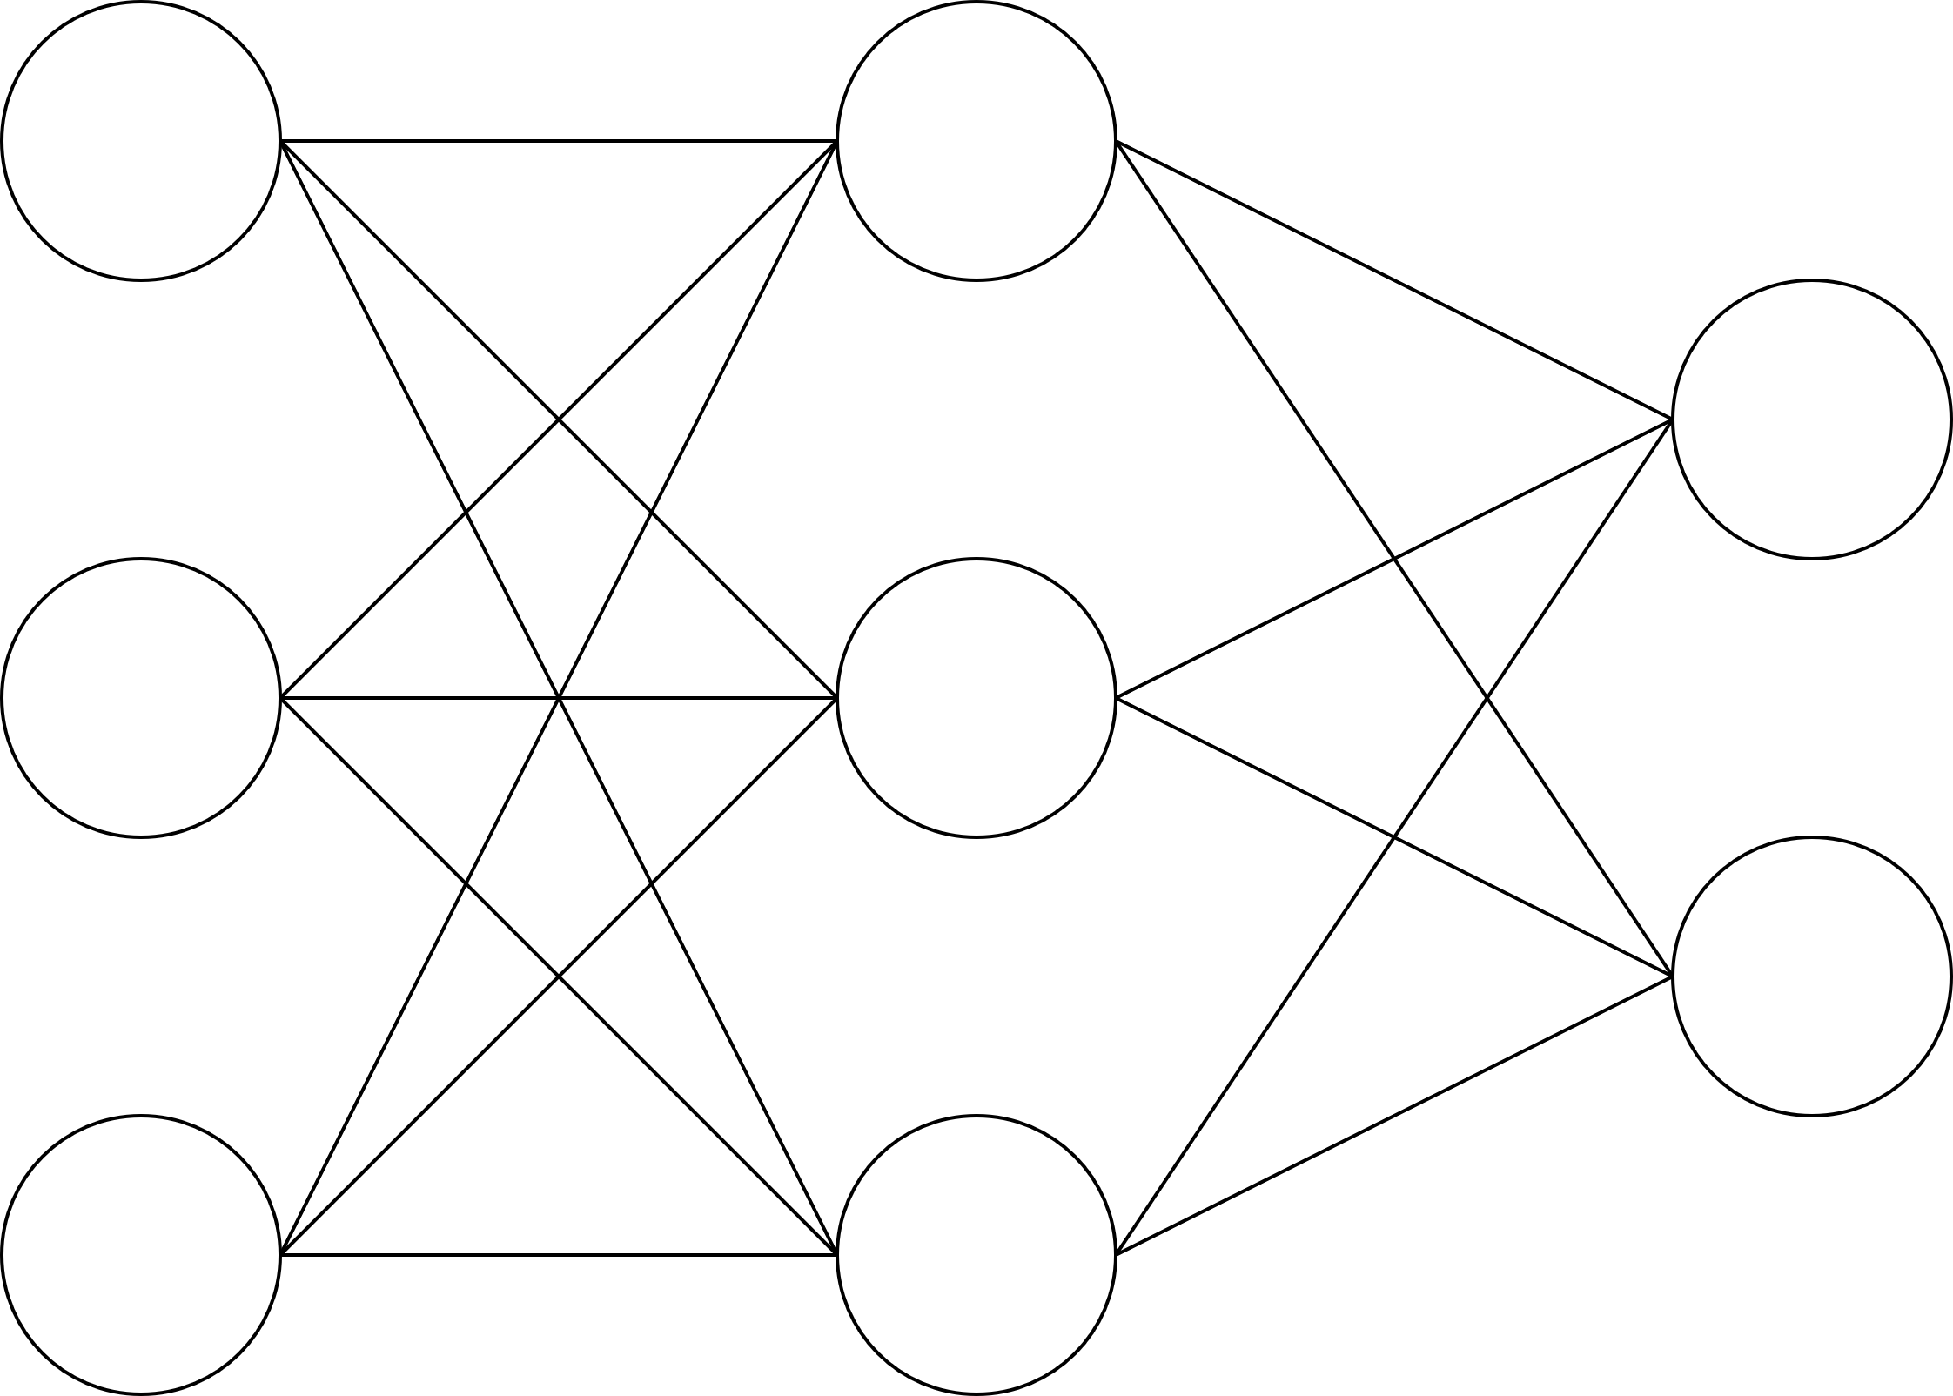
Transfer Learning
Step 1: Setup architecture
input
hidden
output

Slide 4
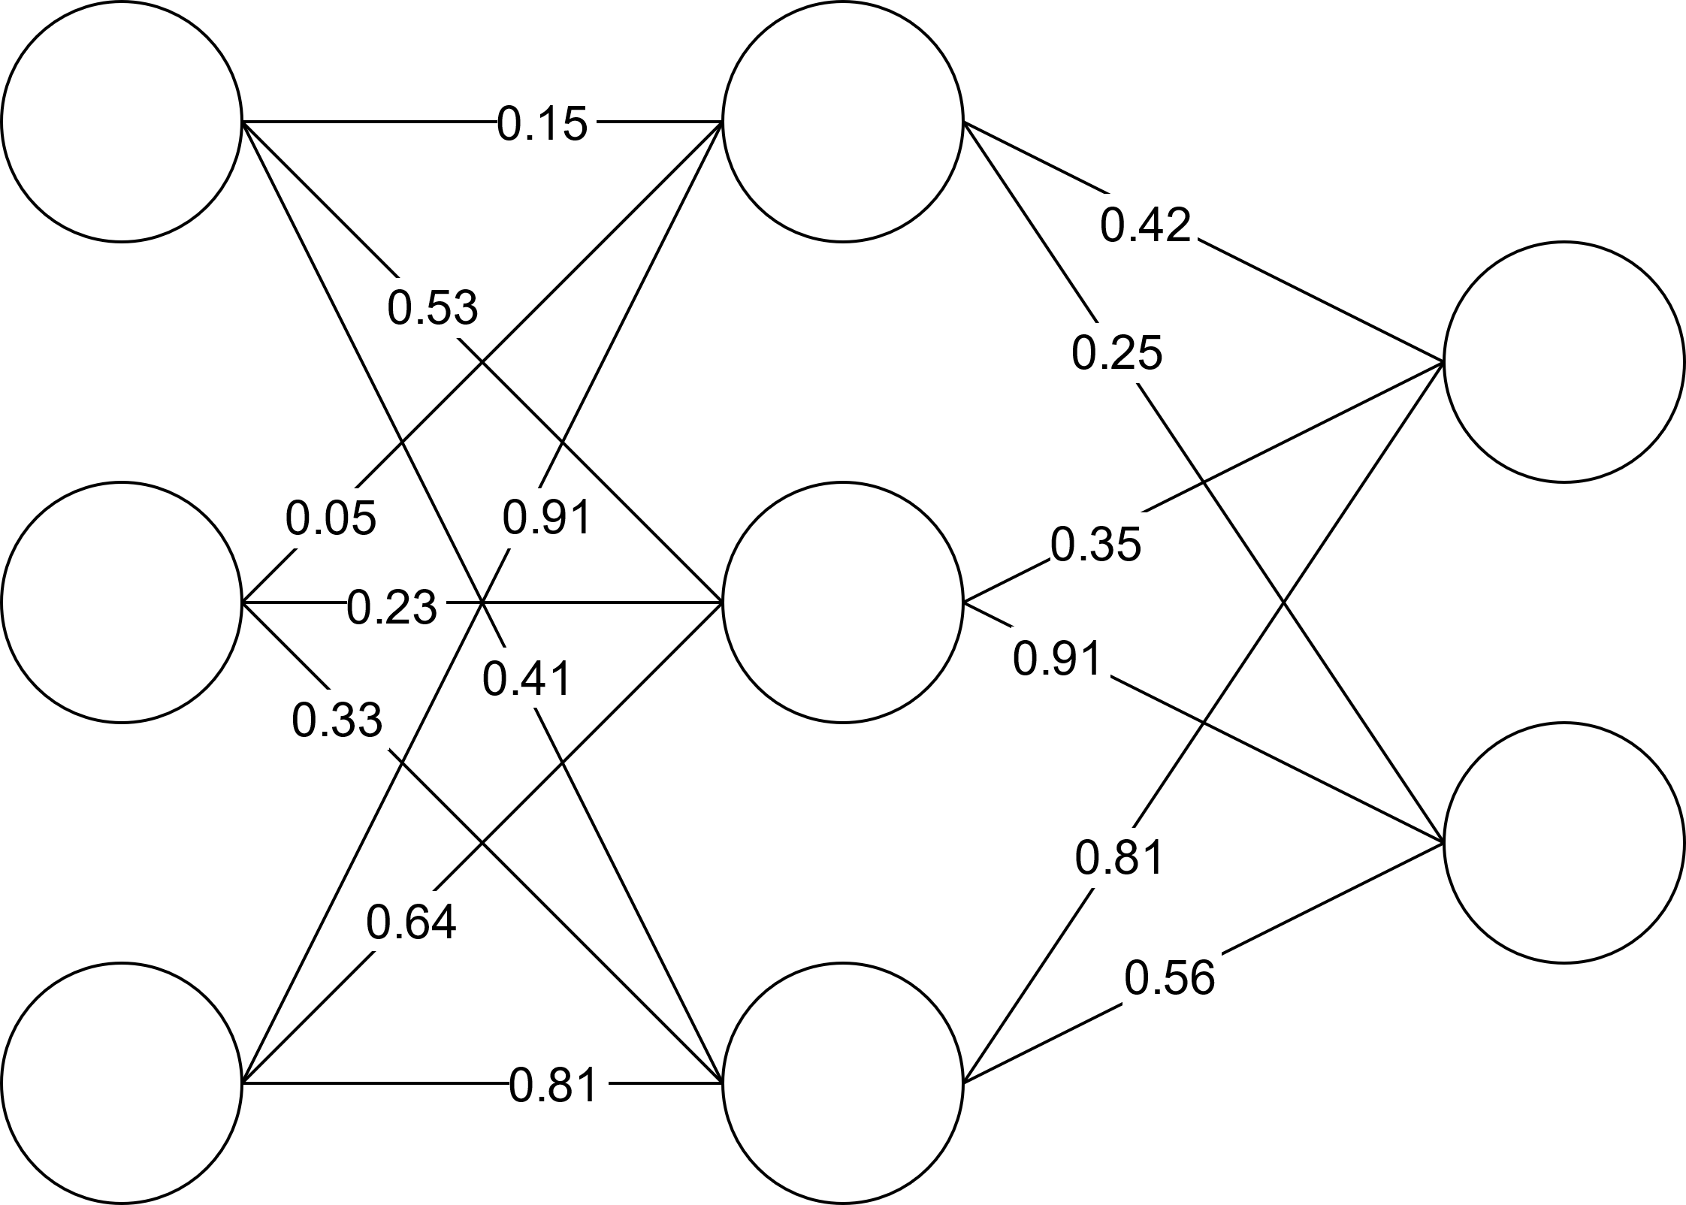
Transfer Learning
Step 2: Train weights on dataset (ie: Imagenet)
input
hidden
output

Slide 5
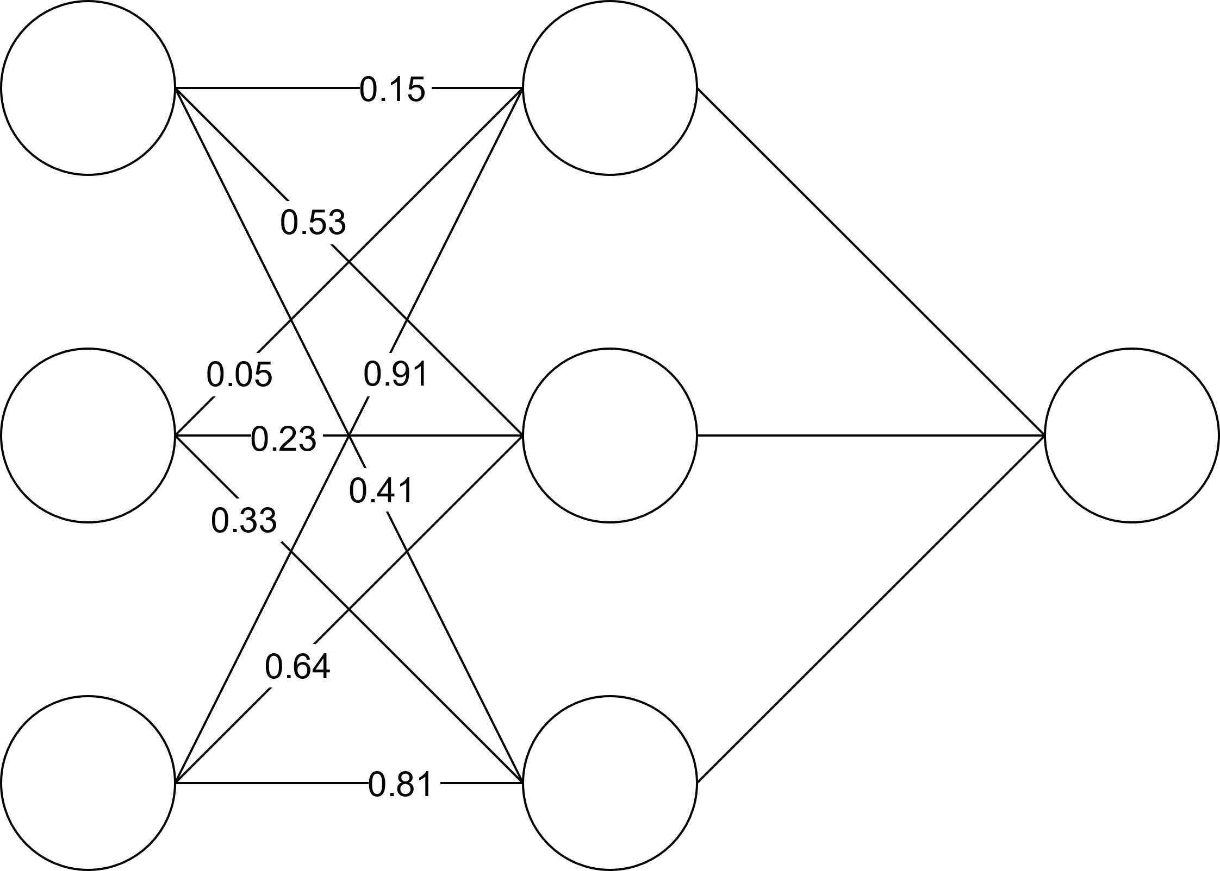
Transfer Learning
Step 3: Freeze learned weights and replace last layer
input
hidden
output

Slide 6
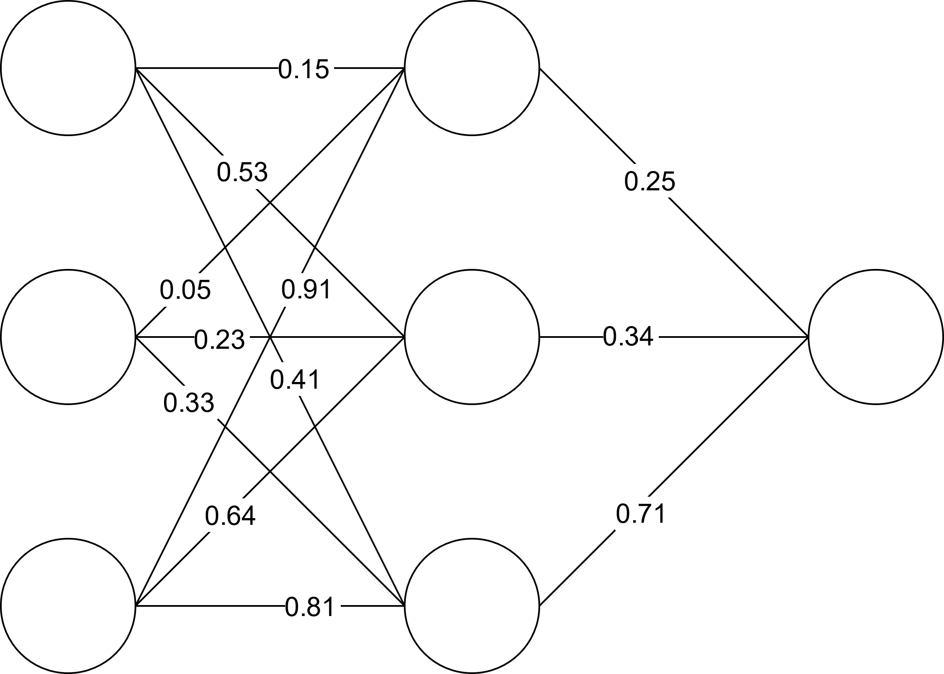
Transfer Learning
Step 4: Train weights between last layer on dataset from new domain (ie: Gabors)
input
hidden
output

Slide 7
Transfer Learning
MobileNetV2 (Sandler et al., 2018)
Base layers trained on Imagenet
VGG16
Base layers trained on Imagenet
Vanilla CNN
Base layers trained on CIFAR10

Slide 8
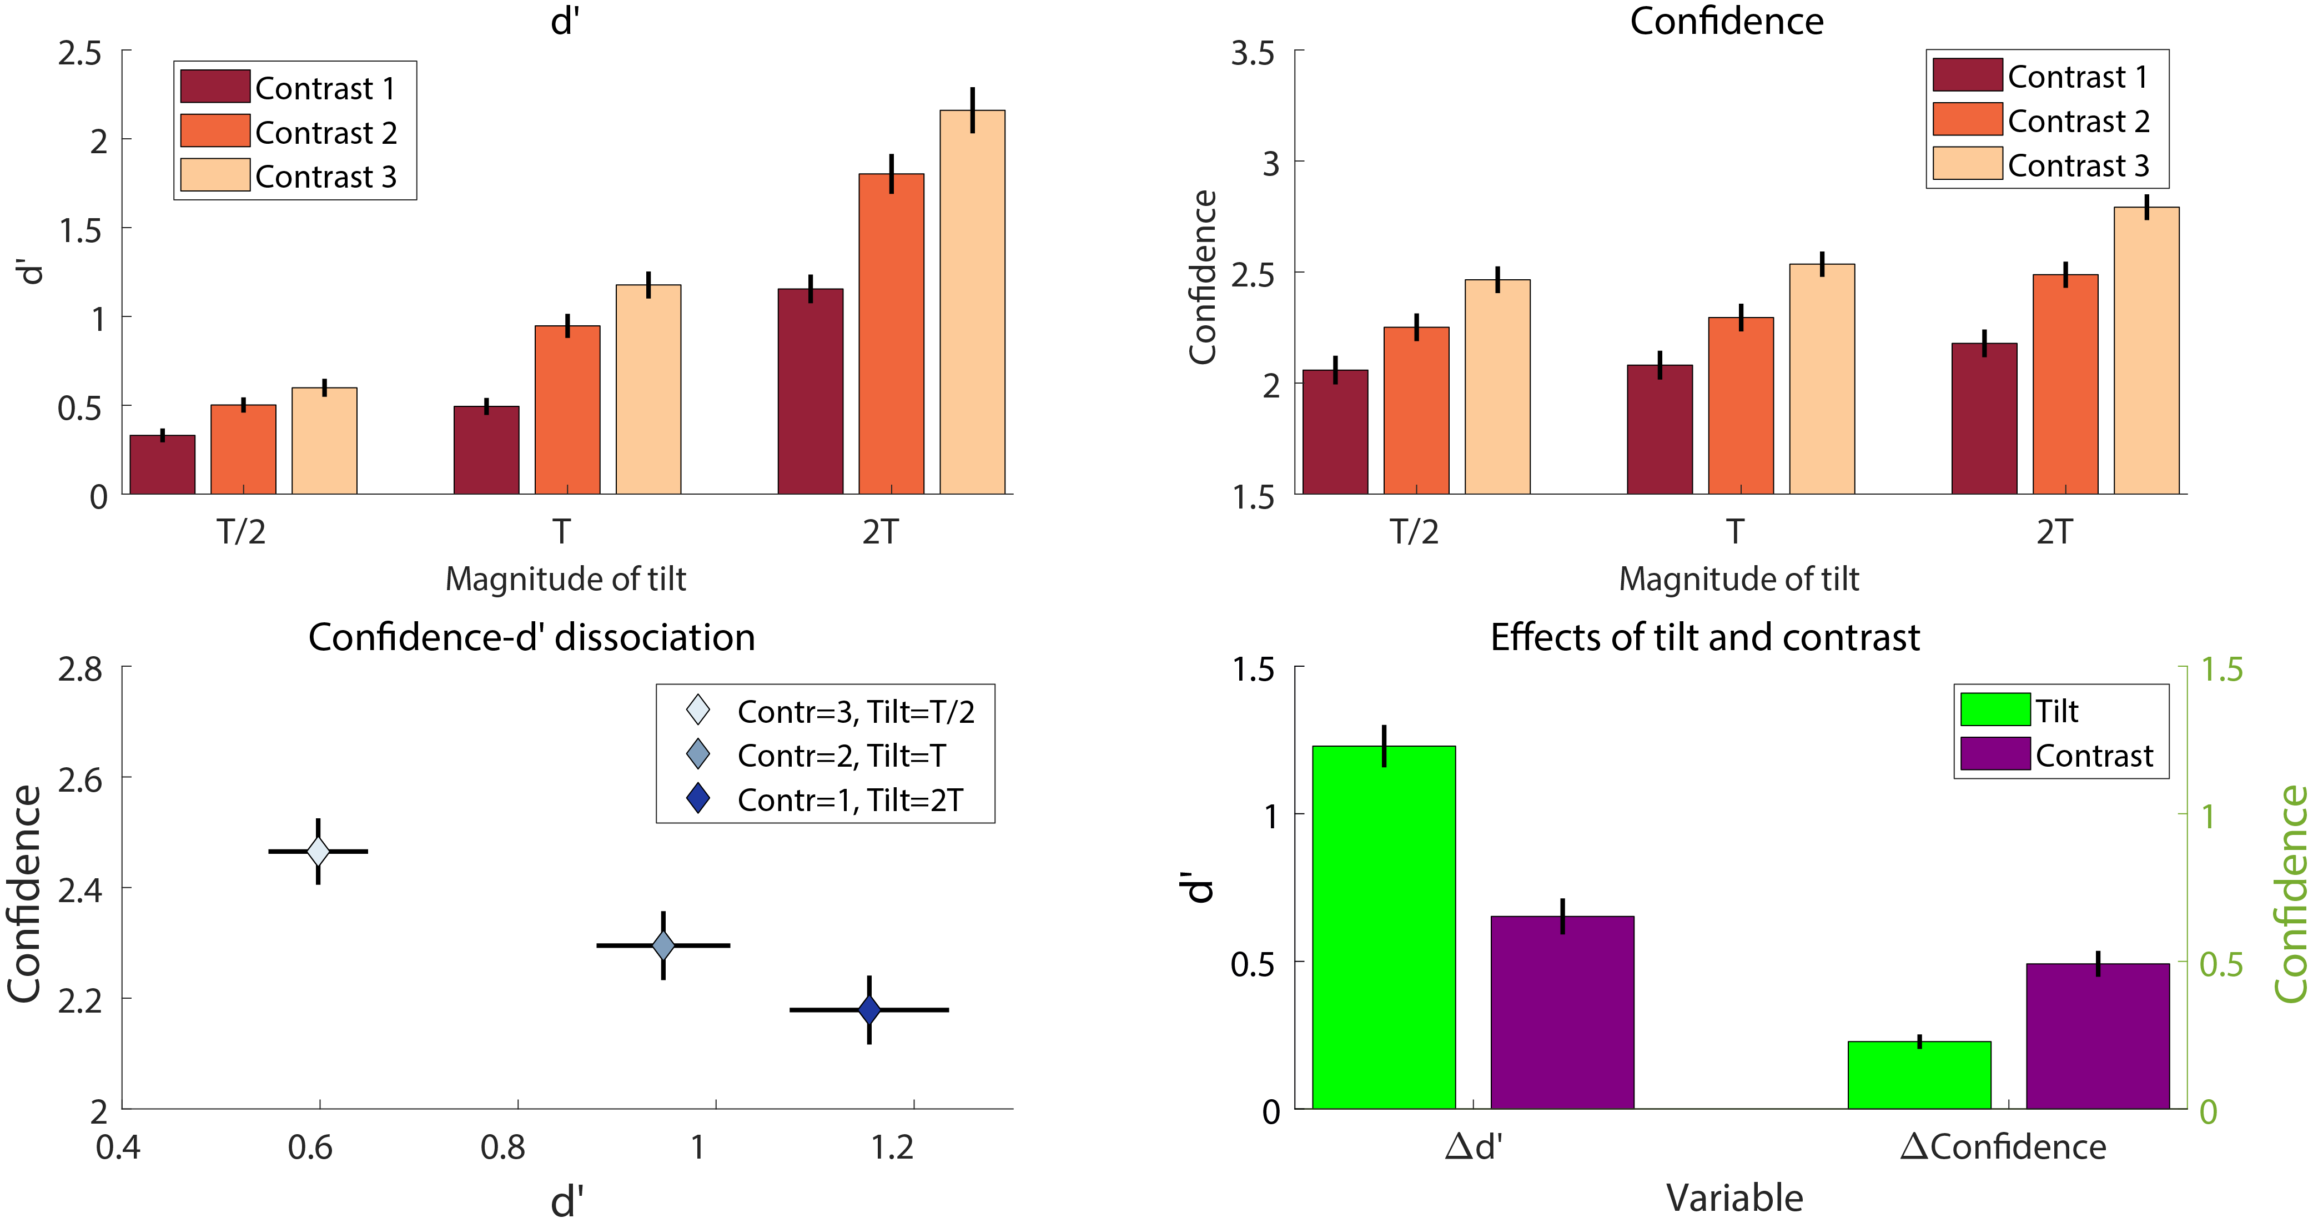
Behavioral Results

Slide 9
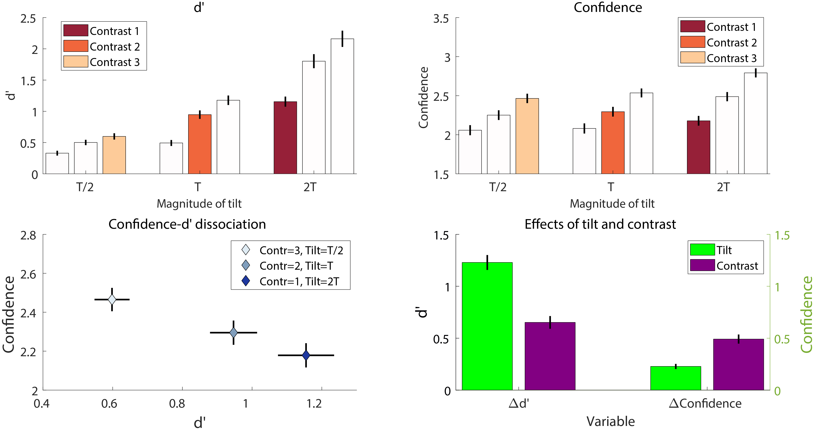
Behavioral Results

